Slide 1

Hector Pena DSC 680 Bellevue University
Cardiovascular Health Analysis

Slide 2
Business Problem
With the rising health concerns in the United States, this project will take a deep dive into how certain individuals meeting certain body criteria may or may not have a higher risk for heart disease and or a heart attack. This data can then be used to educate individuals to change their lifestyle to live and longer and healthier life.

Slide 3
Background
Heart health in the United States has evolved dramatically over the last century, the timeline includes major shifts in disease patterns, scientific discoveries, lifestyle changes, and medical technology. Today heart disease is still the leading cause of death in the U.S., but death rates have dropped significantly since the mid-20th century due to research and prevention efforts
Notes:
In the early 1900’s the leading cause of death was infectious diseases such as tuberculosis and influenza.
As vaccines and antibiotics improved individuals lives longer which revealed more chronic illnesses like heart disease.
Between the 1920’s and 1930’s heart disease began to rise rapidly, but doctors had limited tools for diagnosis.
From the 1940’s and 1960’s this is seen as a turning point as studies like the Framingham Heart Study.
This study followed thousands of residents for decades to identify risk factors for cardiovascular disease.
Between the 1960’s and 1980’s the United States government and organizations like the American Heart Association launched educational campaigns.
These campaigns provided warnings about smoking and heart disease becoming widespread.
Guidelines for nutrition were encouraged, these guidelines helped lower saturated fats, lower cholesterol, and encouraged more fruits and vegetables intake.
Medical Advances were seen to improve between this era shifting into the 1990’s and 2000’s the advancements in medical technology have allowed for bypass surgery, intensive care units, as well as early heart transplants.

Slide 4
Data
The data for this project has been collected from Kaggle.
This dataset has 17 different metrics; such as Patient ID, age, BMI, daily steps, etc.
With these types of metrics, we can show the public what warning signs to look for to avoid or to help reduce cardiovascular disease.

Slide 5
Methods
To get the most of our data we must perform basic EDA to remove any irregularities in our data as well as fill any null values that may be in place. We will also filter our data to segment it by columns so we can get a closer look at certain metrics.
With the metrics in this dataset, we can run a heart disease risk prediction model to help individuals and doctors predict and classify if they are at risk, low risk, or no risk for heart disease.
We can also run a feature importance analysis to highlight which metrics are the most important to keep a good heart health.

Slide 6
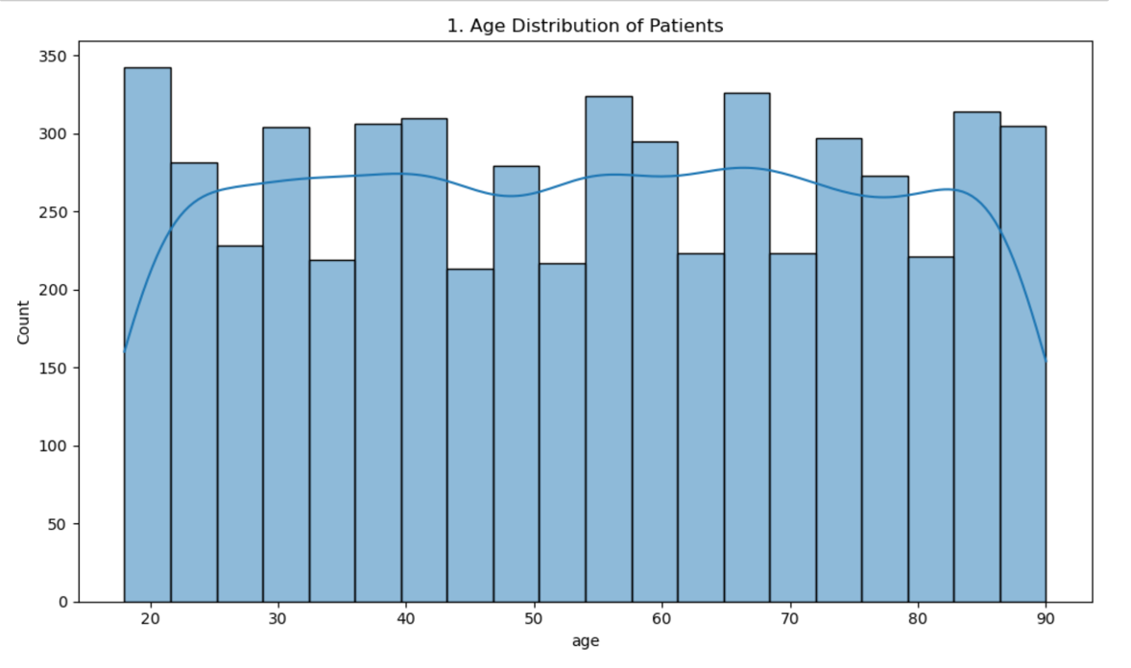
Analysis
After running EDA we can see the distribution of our data, we can see an even spread of ages amongst patients, while slight peaks at the ages 20, 30, 40, 50, etc.

Slide 7
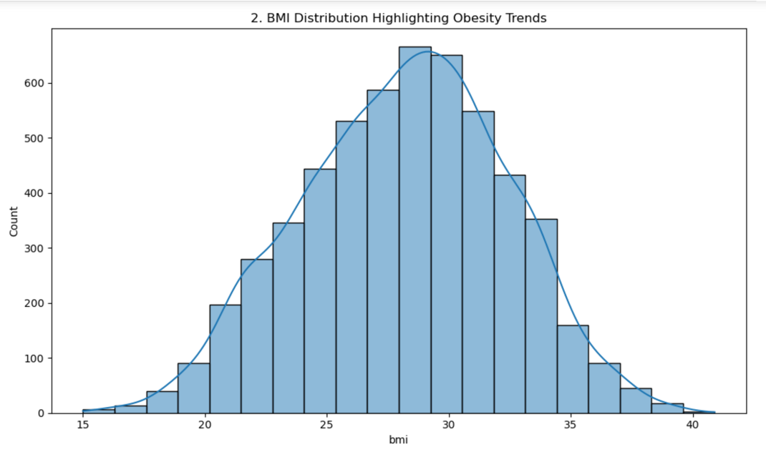
BMI Distribution
Distribution of Body Mass Index (BMI) of patients, this index measures the amount of body fat based on height and weight that applies to adult men and women. In this distribution we can see a normal curve with majority of patients landing between 25 and 33 on the BMI scale.

Slide 8
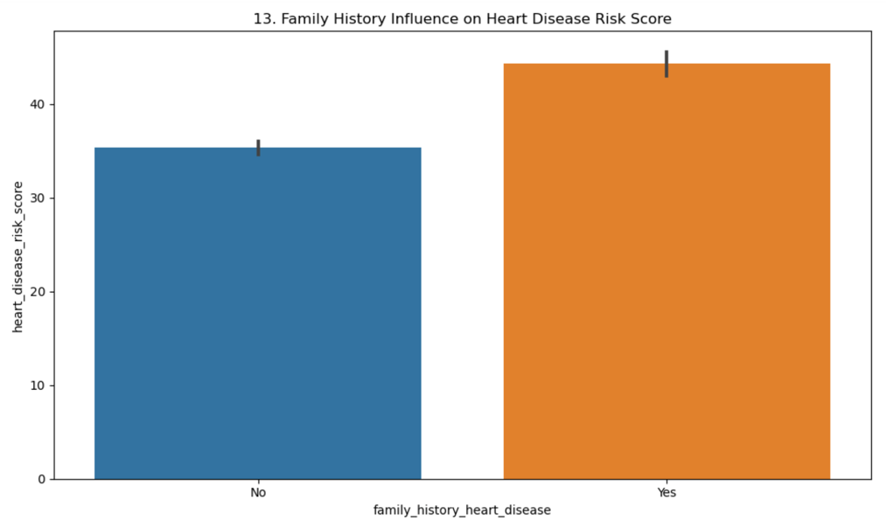
Family History of Heart Disease
We can see that most of our patients have recorded a history of heart disease in their family.

Slide 9
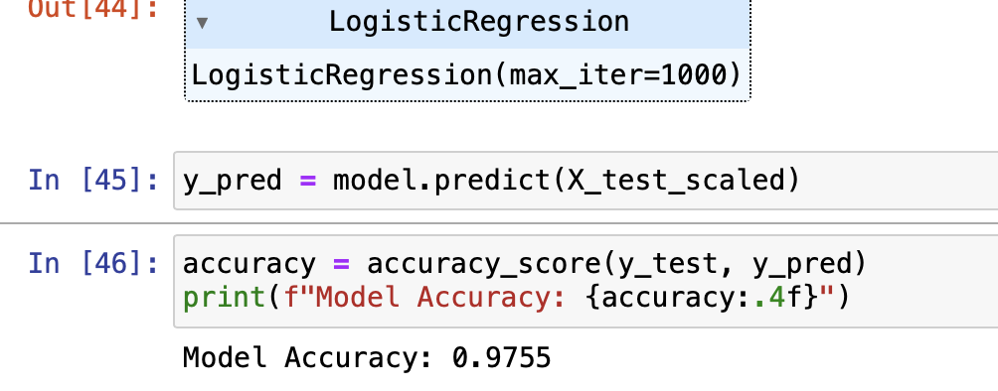
Logistic Regression Model
Looking at a logistic regression model, dropping patient ID and splitting the data into test and train sets, we get a model accuracy rating of 0.9755, showing us that with the metrics in this dataset we can confidently predict if an individual is believed to have heart disease based on the metrics provided.

Slide 10
Conclusion
We can see from the metrics in this dataset that heart health and risk of heart disease have to do with many factors. Us as individuals must consider our stress levels, amount of sleep, and lifestyle choices when thinking of our heart health. We can see that individuals with a higher BMI show a greater risk for heart disease and issues with heart health. One of the main factors of heart health is a family history of heart disease, those patients with history of heart disease have a higher risk of having heart disease themselves versus patients who do not have a history of heart disease.

Slide 11
Challenges
The issues that arise from this is the consideration of race, income, and geographical regions. Studies have shown that some races are at higher risk for heart health and heart disease due to the type of lifestyle they live. Income is also a huge factor, those with lower income or considered to fall into the poverty category do not have the same access to healthy ingredients to live that healthy lifestyle, the convenience of fast-food restaurants and processed foods add to the disparities in income levels.

Slide 12
Ethical Considerations
The one major ethical consideration with this dataset is the use of Patient ID as one of the metrics, this metric can be used to trace the information back to a specific individual. To combat this, I have removed this metric and only focus on information that cannot be traced back to one specific individual.

Slide 13
Recommendations
For patients to continue to improve their heart health, I recommend a complete lifestyle change for those at risk and those who have been diagnosed with heart disease. This lifestyle change will include changes to their exercise routine, sleep routine, and most importantly their eating patterns. With these lifestyle changes patients can improve their health drastically and live a long and healthy life.

Slide 14
References
American Heart Association: To be a relentless force for a world of longer, healthier lives. www.heart.org. (n.d.). https://www.heart.org/
Centers for Disease Control and Prevention. (2025, February 27). Homepage - Health, United States. Centers for Disease Control and Prevention. https://www.cdc.gov/nchs/hus/
Centers for Disease Control and Prevention. (n.d.). Heart disease facts. Centers for Disease Control and Prevention. https://www.cdc.gov/heart-disease/data-research/facts-stats/?CDC_AAref_Val=https%3A%2F%2Fwww.cdc.gov%2Fheartdisease%2Ffacts.htm
Dietary guidelines for Americans. Dietary Guidelines for Americans. (n.d.). https://www.dietaryguidelines.gov/
Mensah, G. A., Wei, G. S., Sorlie, P. D., Fine, L. J., Rosenberg, Y., Kaufmann, P. G., Mussolino, M. E., Hsu, L. L., Addou, E., Engelgau, M. M., & Gordon, D. (2017). Decline in cardiovascular mortality. Circulation Research, 120(2), 366–380. https://doi.org/10.1161/circresaha.116.309115

